Slide 1

Rust Lightning Talks
Rust User Group Perth
Notes:
You may replace this with your title page

Slide 2
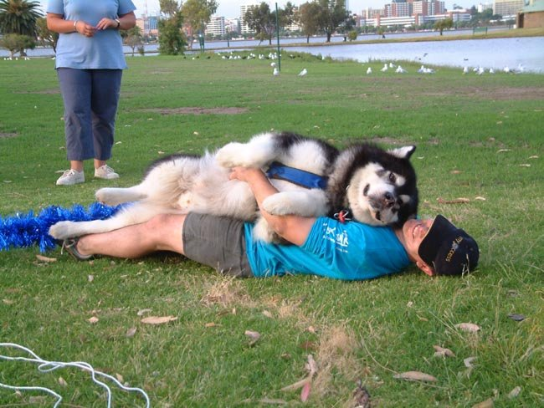



Paul McGee Manager and Dogsbody McGee Newsagents {linkedin}/ paul-mcgee-functional paul.mcgee.8@bigpond.com
Notes:
This is your intro slide. Replace the template details with yours. Fill in your details. It does not autoadvance. The presentation starts after this slide

Slide 3
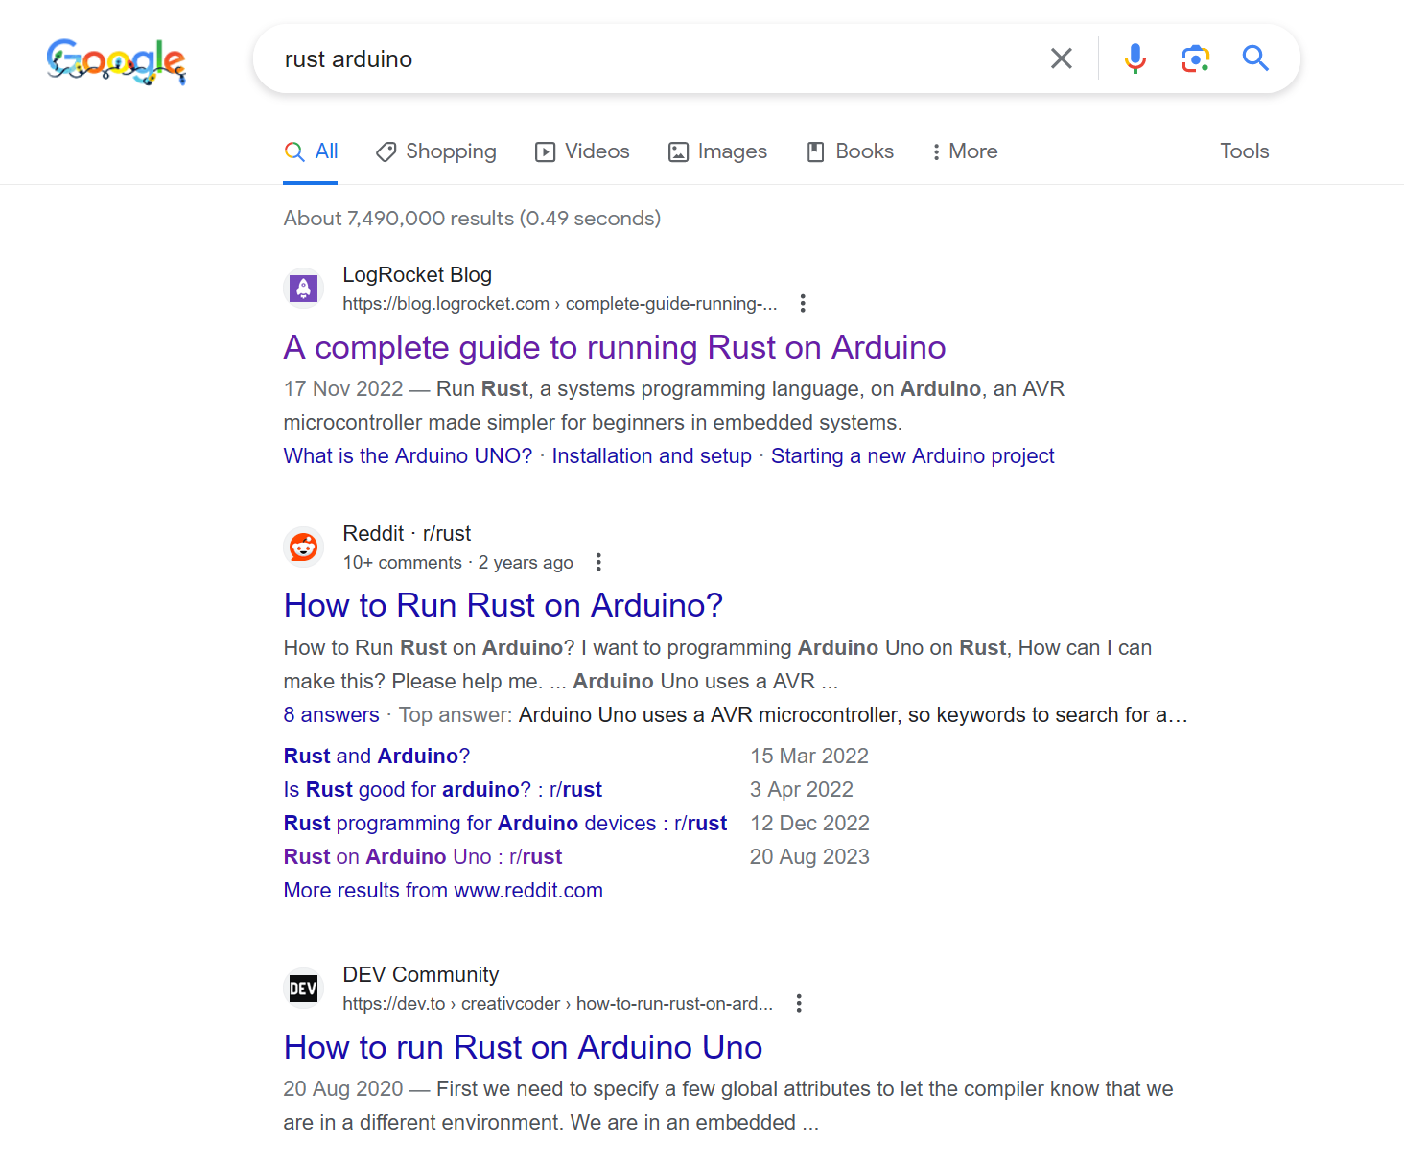

1
Googled 'Rust Arduino'
Notes:
You have 20 slides, 15 seconds per slide, auto-advancing. I recommend you put a picture on each slide. Words/title are optional. The timing is already applied, don’t mess with that. Normally you have time to speak 1-2 sentences per slide

Slide 4
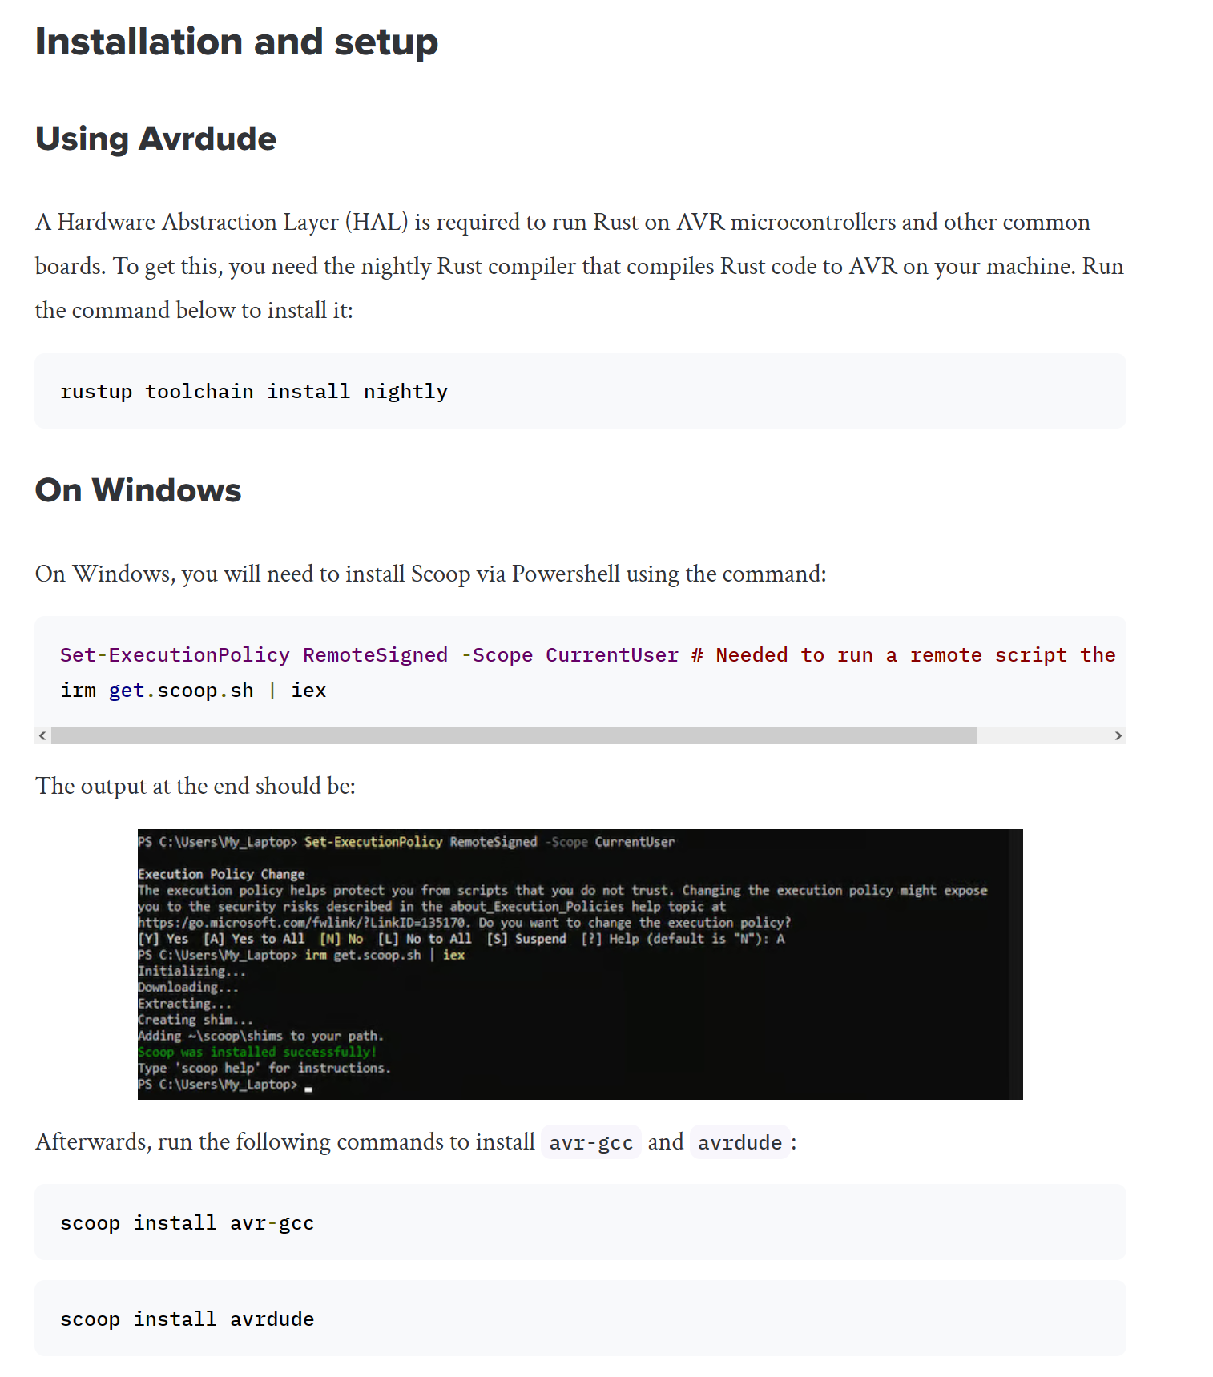
2
Follow instructions
Notes:
You have 20 slides, 15 seconds per slide, auto-advancing. I recommend you put a picture on each slide. Words/title are optional. The timing is already applied, don’t mess with that. Normally you have time to speak 1-2 sentences per slide

Slide 5
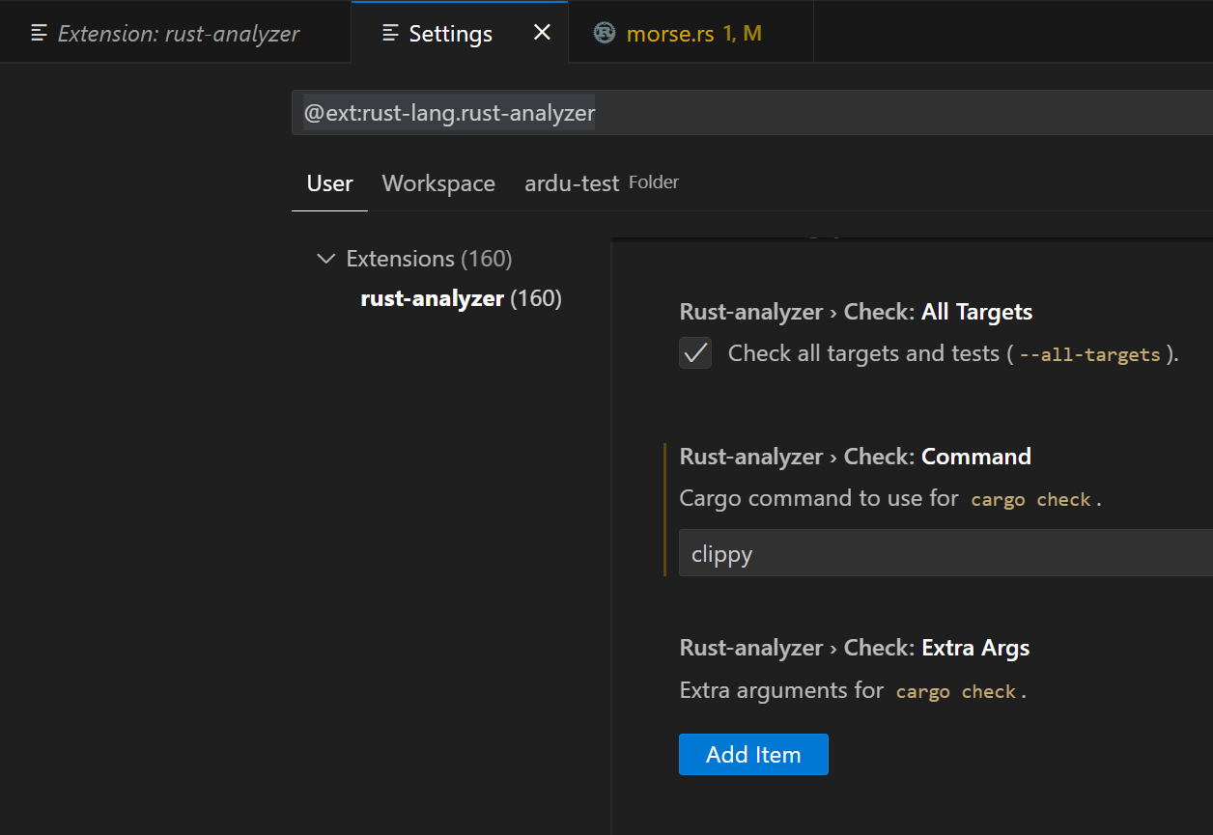
3
VS Code + rust-analyzer + clippy
Notes:
You have 20 slides, 15 seconds per slide, auto-advancing. I recommend you put a picture on each slide. Words/title are optional. The timing is already applied, don’t mess with that. Normally you have time to speak 1-2 sentences per slide

Slide 6
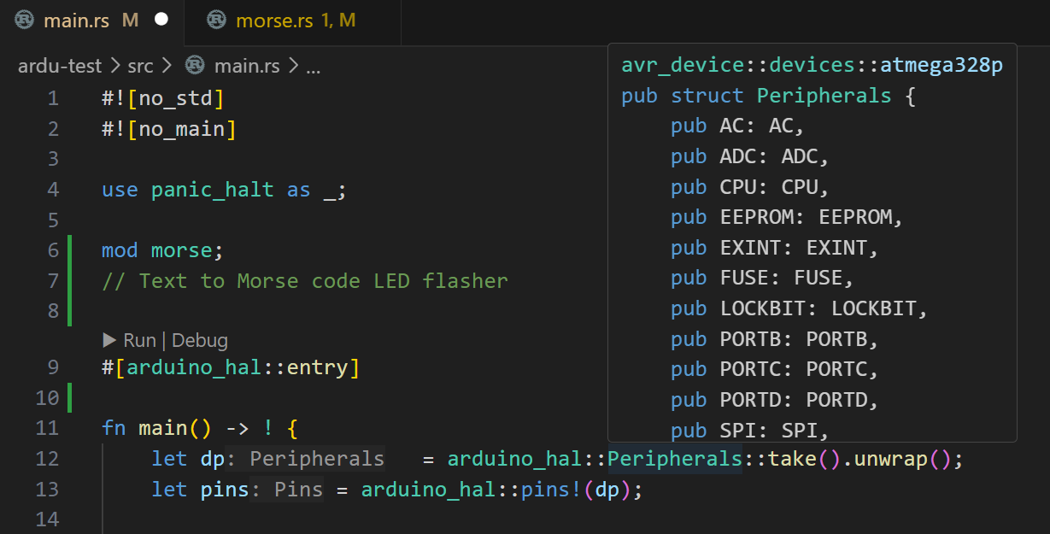
4
VS Code + rust-analyzer + clippy
Notes:
You have 20 slides, 15 seconds per slide, auto-advancing. I recommend you put a picture on each slide. Words/title are optional. The timing is already applied, don’t mess with that. Normally you have time to speak 1-2 sentences per slide

Slide 7
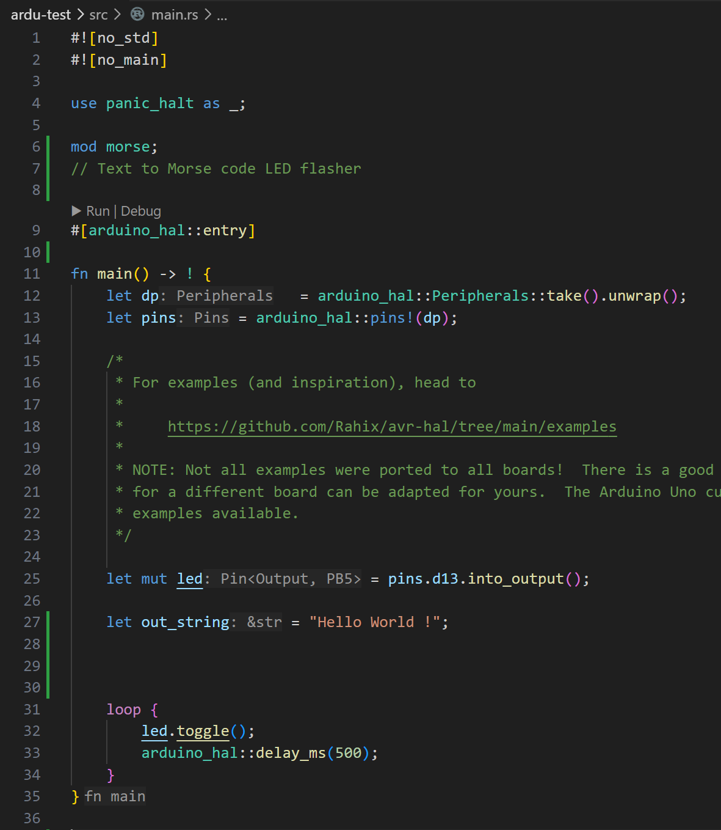
5
Starting point. It works!
Notes:
You have 20 slides, 15 seconds per slide, auto-advancing. I recommend you put a picture on each slide. Words/title are optional. The timing is already applied, don’t mess with that. Normally you have time to speak 1-2 sentences per slide

Slide 8
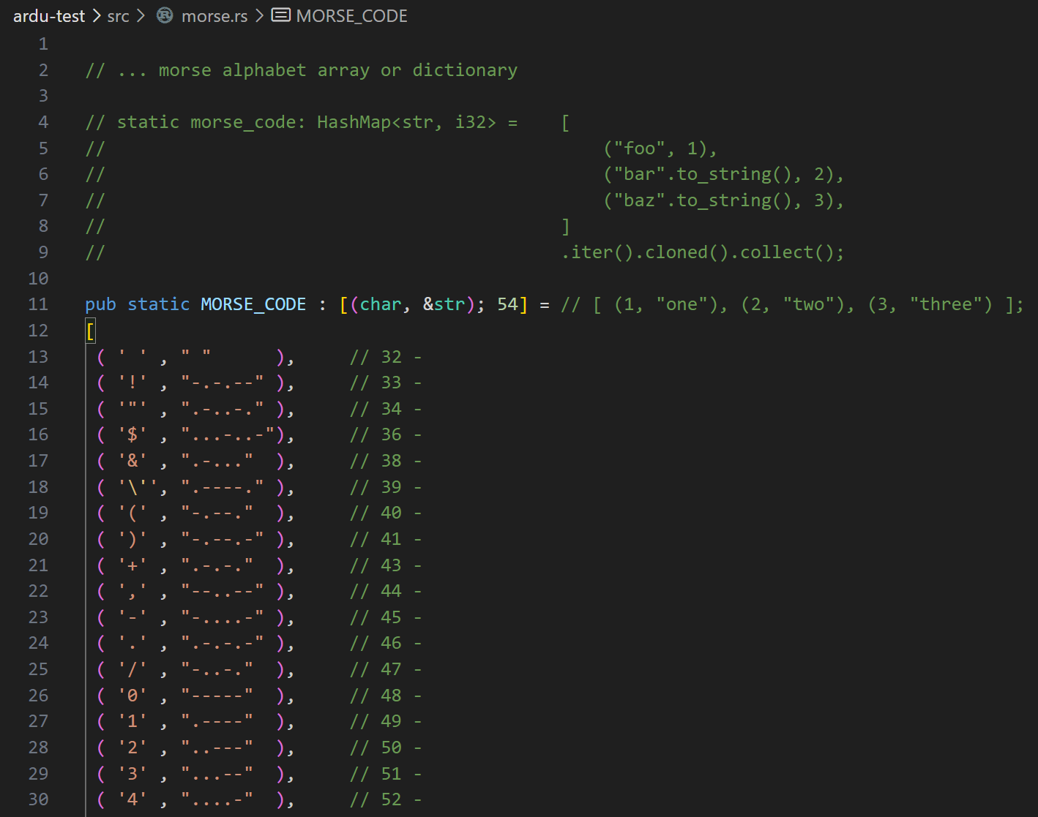
6
No std. Ergo Tuples !
Notes:
You have 20 slides, 15 seconds per slide, auto-advancing. I recommend you put a picture on each slide. Words/title are optional. The timing is already applied, don’t mess with that. Normally you have time to speak 1-2 sentences per slide

Slide 9
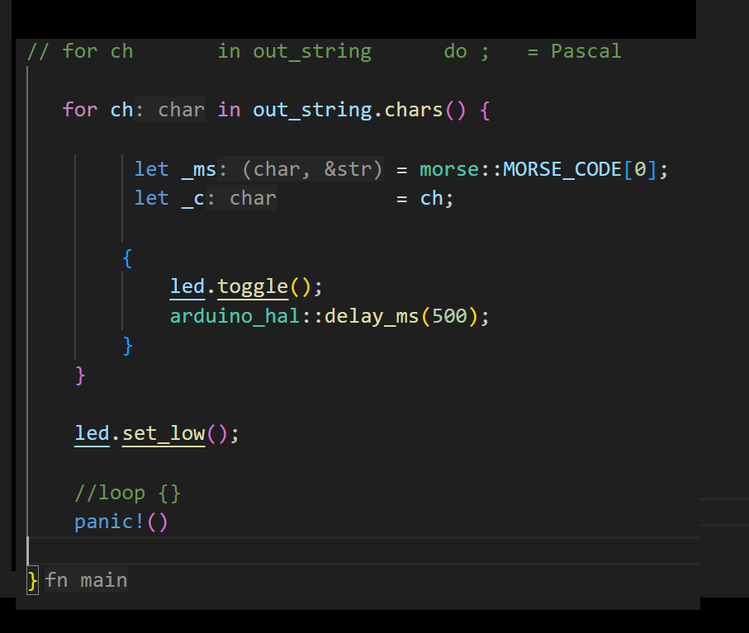
7
Pascal syntax! 😃🔥🎉
Notes:
You have 20 slides, 15 seconds per slide, auto-advancing. I recommend you put a picture on each slide. Words/title are optional. The timing is already applied, don’t mess with that. Normally you have time to speak 1-2 sentences per slide

Slide 10
8
'Shared' data structure = pub static
_var = anonymous
Notes:
You have 20 slides, 15 seconds per slide, auto-advancing. I recommend you put a picture on each slide. Words/title are optional. The timing is already applied, don’t mess with that. Normally you have time to speak 1-2 sentences per slide

Slide 11
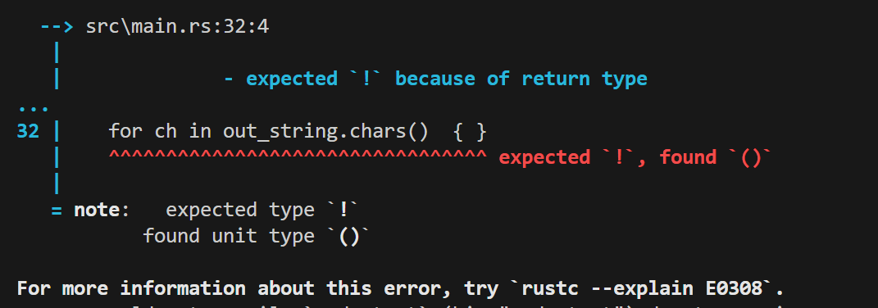
9
fn main() -> ! {…} = non-terminating main
Notes:
You have 20 slides, 15 seconds per slide, auto-advancing. I recommend you put a picture on each slide. Words/title are optional. The timing is already applied, don’t mess with that. Normally you have time to speak 1-2 sentences per slide

Slide 12
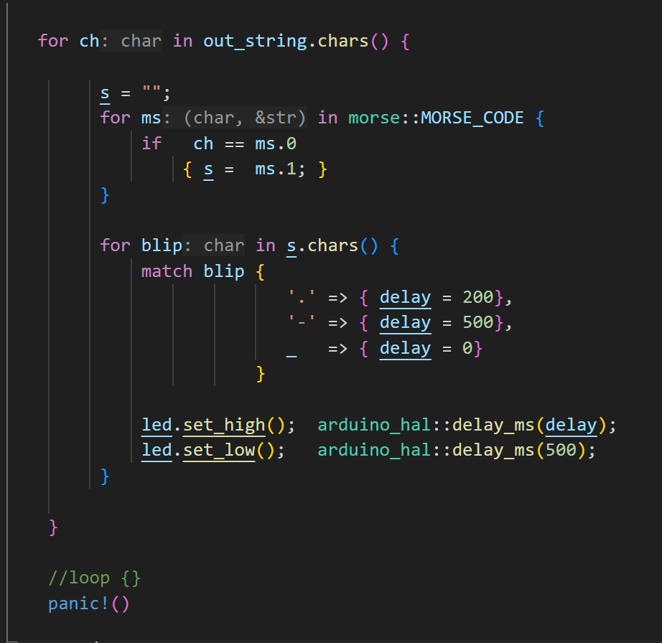
10
Working …
Hmmm …
Only counted 13 flashes
🤔
Ahhh … I'll take it.
Notes:
You have 20 slides, 15 seconds per slide, auto-advancing. I recommend you put a picture on each slide. Words/title are optional. The timing is already applied, don’t mess with that. Normally you have time to speak 1-2 sentences per slide

Slide 13
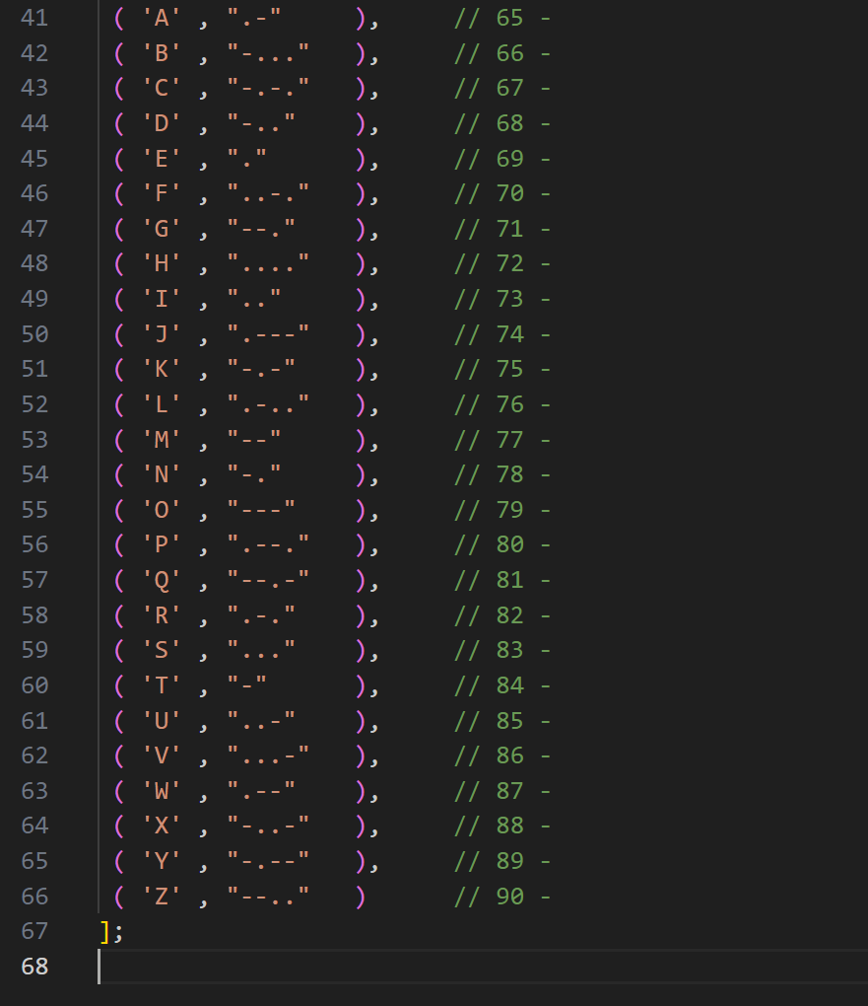
11
Fine.
I'll look at the morse code strings.
Ummmmm …
Notes:
You have 20 slides, 15 seconds per slide, auto-advancing. I recommend you put a picture on each slide. Words/title are optional. The timing is already applied, don’t mess with that. Normally you have time to speak 1-2 sentences per slide

Slide 14
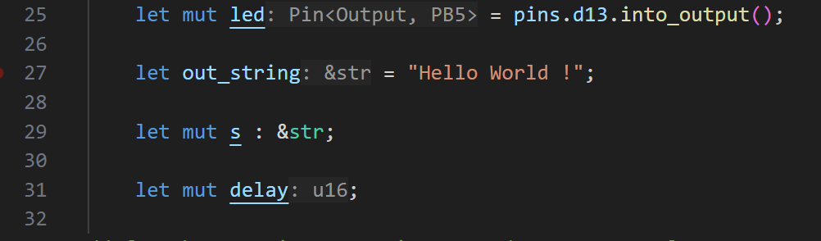
12
Grrrrrr.
Notes:
You have 20 slides, 15 seconds per slide, auto-advancing. I recommend you put a picture on each slide. Words/title are optional. The timing is already applied, don’t mess with that. Normally you have time to speak 1-2 sentences per slide

Slide 15
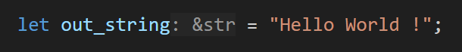
13
Grrrrrr.
Notes:
You have 20 slides, 15 seconds per slide, auto-advancing. I recommend you put a picture on each slide. Words/title are optional. The timing is already applied, don’t mess with that. Normally you have time to speak 1-2 sentences per slide

Slide 16
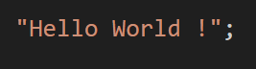
14
You idiot. 😐 😖
Notes:
You have 20 slides, 15 seconds per slide, auto-advancing. I recommend you put a picture on each slide. Words/title are optional. The timing is already applied, don’t mess with that. Normally you have time to speak 1-2 sentences per slide

Slide 17
15
*Cough* … "HELLO WORLD"
Notes:
You have 20 slides, 15 seconds per slide, auto-advancing. I recommend you put a picture on each slide. Words/title are optional. The timing is already applied, don’t mess with that. Normally you have time to speak 1-2 sentences per slide

Slide 18
16
THANK YOU ALL 😺 For your time … and for the motivation to experiment with it.
Notes:
You have 20 slides, 15 seconds per slide, auto-advancing. I recommend you put a picture on each slide. Words/title are optional. The timing is already applied, don’t mess with that. Normally you have time to speak 1-2 sentences per slide

